Slide 1

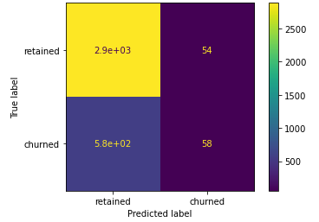
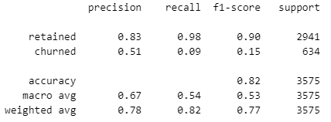
User Churn Project
Prepared for: Waze Leadership Team
Project Overview
The Waze data team is currently developing a data analytics project aimed at increasing overall growth by preventing monthly user churn on the Waze app. Waze wants to have a logistic regression model that predicts whether a user is likely to churn. This report offers information on the project status and results of Milestone 5.
`activity_days` is the most important feature in the model. It has a negative correlation with user churn. This variable is strongly correlated with `driving_days`
User churn rate increased as the values in `km_per_driving_day` increased. The correlation heatmap revealed this variable to have the strongest positive correlation with churn of any of the predictor variables. However, in the model, it was the second-least-important variable
New features could be engineered to try to generate better predictive signal. `professional_driver` was the third-most-predictive predictor. It could also be helpful to scale the predictor variables, and/or to reconstruct the model with different combinations of predictor variables to reduce noise from unpredictive features
Discuss model use with Waze Management. If it's used to drive consequential business decisions, the model is not a strong enough predictor, as made clear by its poor recall score. However, if the model is only being used to guide further exploratory efforts, then it can have value.
Consider adding other features at drive-level info

